Slide 1
MSc CGE – MathsGfx1 – Coursework2: Building Generation with 3D L-System
Team: Wanganning Wu, Madina Berkaliyeva

Slide 2
Introduction
L-System is a parallel rewriting system that can be used for procedural buildings generation.
There are several ways to generate buildings procedurally using L-Systems:
Generate the building mass using volumes;
Use meshes that represent walls as the base shapes;

Slide 3
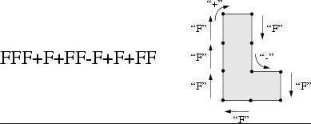
Implementing Walls
Instead of generating a line segment like how it does in using 2D L-System to draw a tree, it generate a rectangle surface
Connect the end point and the starting point and create a wall in between

Slide 4
Implementing Floor : Extension
P’
p
p

Slide 5
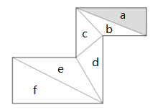
Implementing Floor
Since the floor may have a concave shape, we need to triangulate it.
One way to triangulate a simple polygon, that has no holes, is called Ear-Clipping algorithm.
The algorithm then consists of finding
such an ear, removing it from the polygon
(which results in a new polygon that still
meets the conditions) and repeating
until there is only one triangle left.

Slide 6
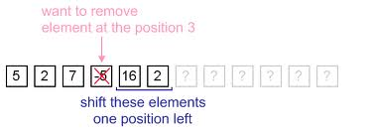
Doubly-linked and Circular List
-5
7
16
7
16
2
2
2
2
5
5

Slide 7
Implementing Windows
We extend the basic L-System rules, so now we can specify windows, window size and balconies:
K – place windows on the wall
(1.50) – set the size of the window to 1.50
B – place balcony on the wall
F+FK(1.50)K-FBK+FK(1.50)KFFK+FK(1.50)K

Slide 8
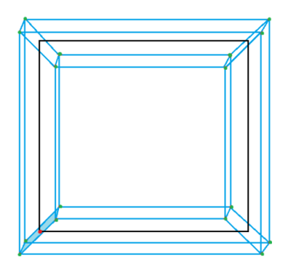
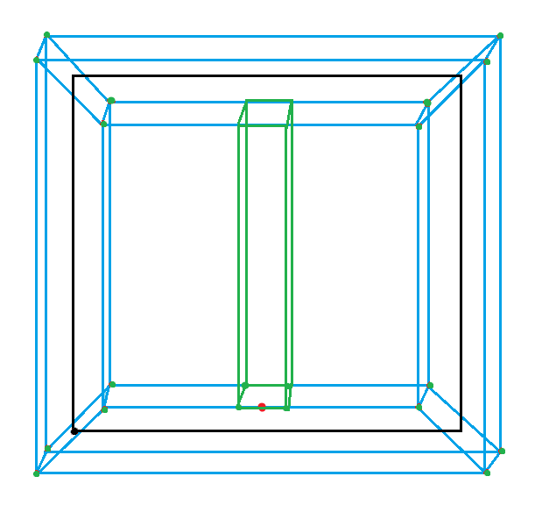
Implementing Frame and Balcony
Window frame
Balcony

Slide 9
Conclusion
Next steps:
The next step would be adding more details to the building;
Making each floor of the building different from each other;
Adding various roofs, window and balcony shapes, stairs and etc.
Applications:
Procedural City Generation
Architecture

Slide 10
Bibliography
2014. Procedural Modelling of Buildings [ONLINE] Available at: http://citeseerx.ist.psu.edu/viewdoc/download?rep=rep1&type=pdf&doi=10.1.1.112.183. [Accessed 6 January 2014];
PARISH, Y. I. H., M̈ULLER, P. 2001. Procedural modelling of cities. In Proceedings of ACM IGGRAPH 2001, ACM Press, E. Fiume, Ed.,301–308;
3Daet.com | L-system City . 2014. 3Daet.com | L-system City . [ONLINE] Available at: http://www.3daet.com/pages/805/l-system_city/. [Accessed 6 January 2014];
Polygon triangulation - Wikipedia, the free encyclopedia. 2014. Polygon triangulation - Wikipedia, the free encyclopedia. [ONLINE] Available at: http://en.wikipedia.org/wiki/Polygon_triangulation. [Accessed 5 January 2014];
Polygon Triangulation. 2014. Polygon Triangulation. [ONLINE] Available at: http://www.cs.unc.edu/~dm/CODE/GEM/chapter.html#FIG. [Accessed 5 January 2014];
2014. [ONLINE] Available at: http://www.cs.ucsb.edu/~suri/cs235/Triangulation.pdf. [Accessed 29 December 2013] ;
Polygon Partitioning. 2014. Polygon Partitioning. [ONLINE] Available at: http://www.personal.kent.edu/~rmuhamma/Compgeometry/MyCG/PolyPart/polyPartition.htm. [Accessed 5 January 2014].

